Slide 1
An Introduction to
Edinburgh Waterfront
Alison Kirkwood
Majors Waterfront Team Manager
City of Edinburgh Council
Waterfront Regeneration Seminar 3
9 January 2015

Slide 2
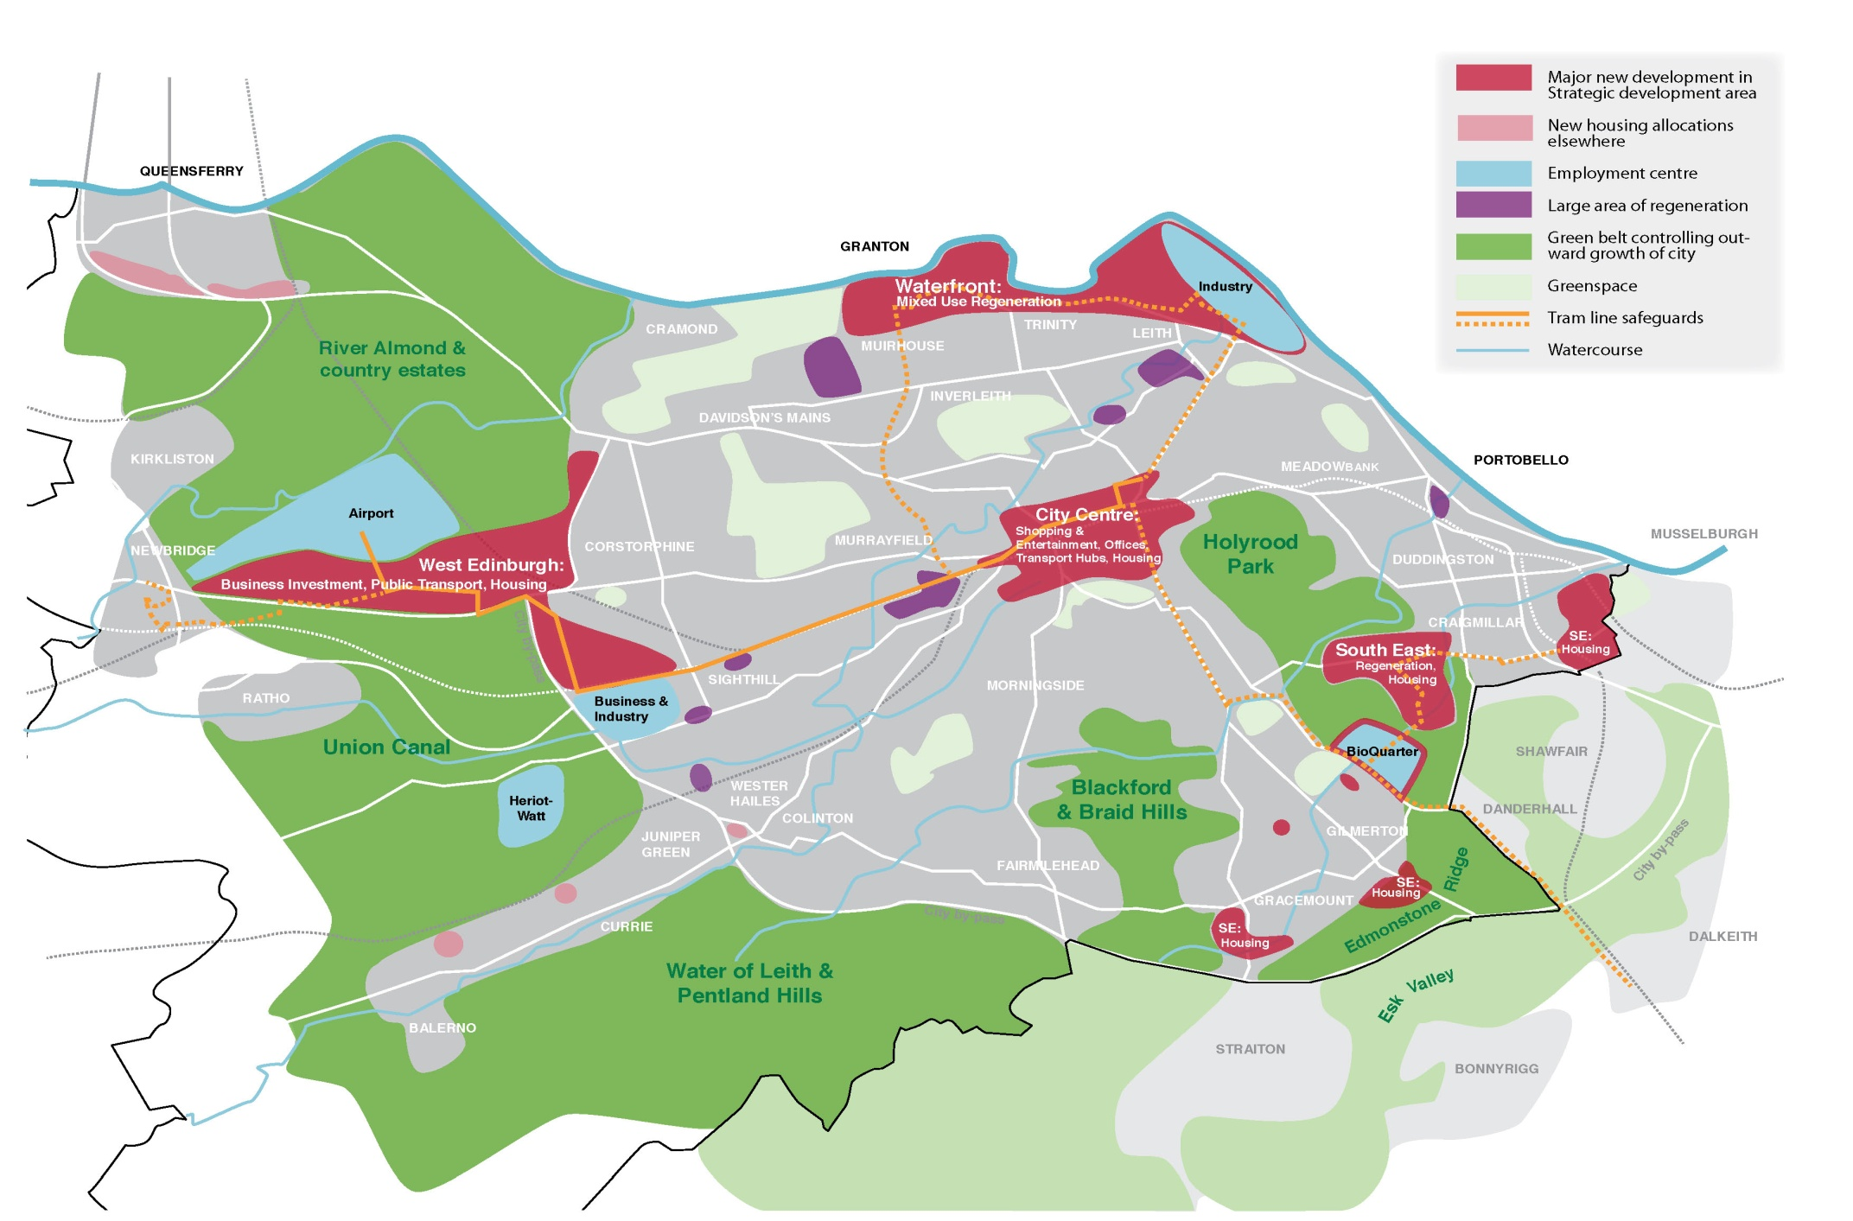
Local Development Plan
Spatial Strategy

Slide 3
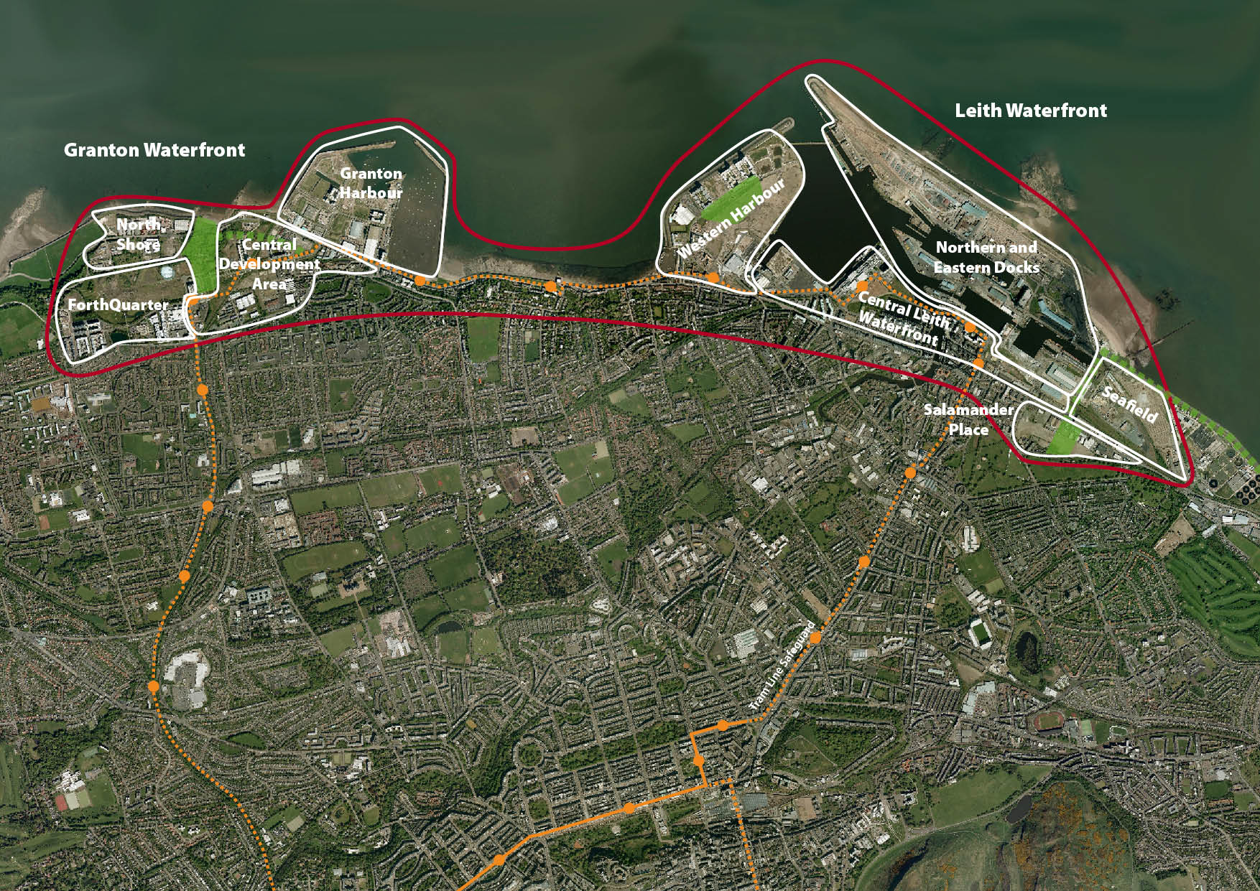
Waterfront SDA Overview
Edinburgh Waterfront Overview

Slide 4
The Vision
Back in 2000, vision to create a “waterfront of international stature”
350 hectares of former industrial land
18km of coastline
Mixed use development
High quality and sustainable urban form
Place-making which involves and benefits existing communities
Tram Network and Edinburgh Promenade

Slide 5
Planning Context
Local Plans and Proposed Local Development Plan
Waterfront Granton Master Plan Dec 2000
Leith Docks Development Framework 2005
Area Development Framework
Various outline permissions and other applications, revisions, extensions etc

Slide 6
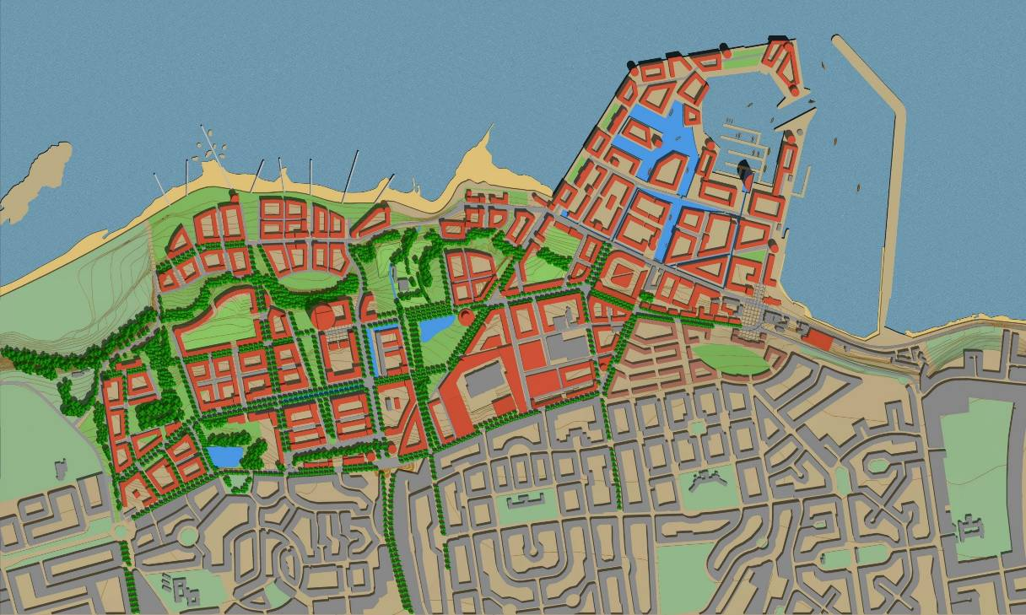
Granton Waterfront
Master Plan (Llewelyn–Davies 2000)
40 hectare site.
100-340,000 m² business space.
5,000-6,500 residential units.
Education, Cultural, retail, leisure, open space
4 Urban Quarters
Social and physical integration

Slide 7
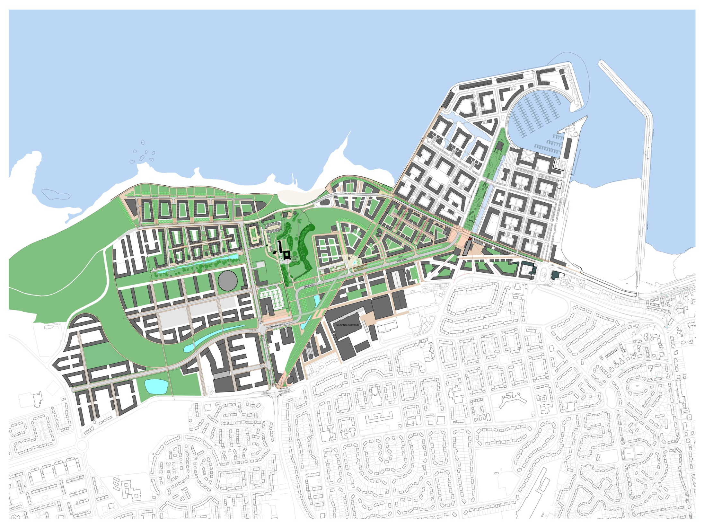
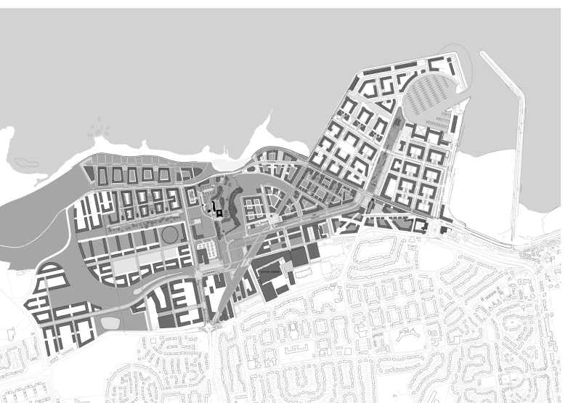
Land Ownership at Granton Waterfront

Slide 8
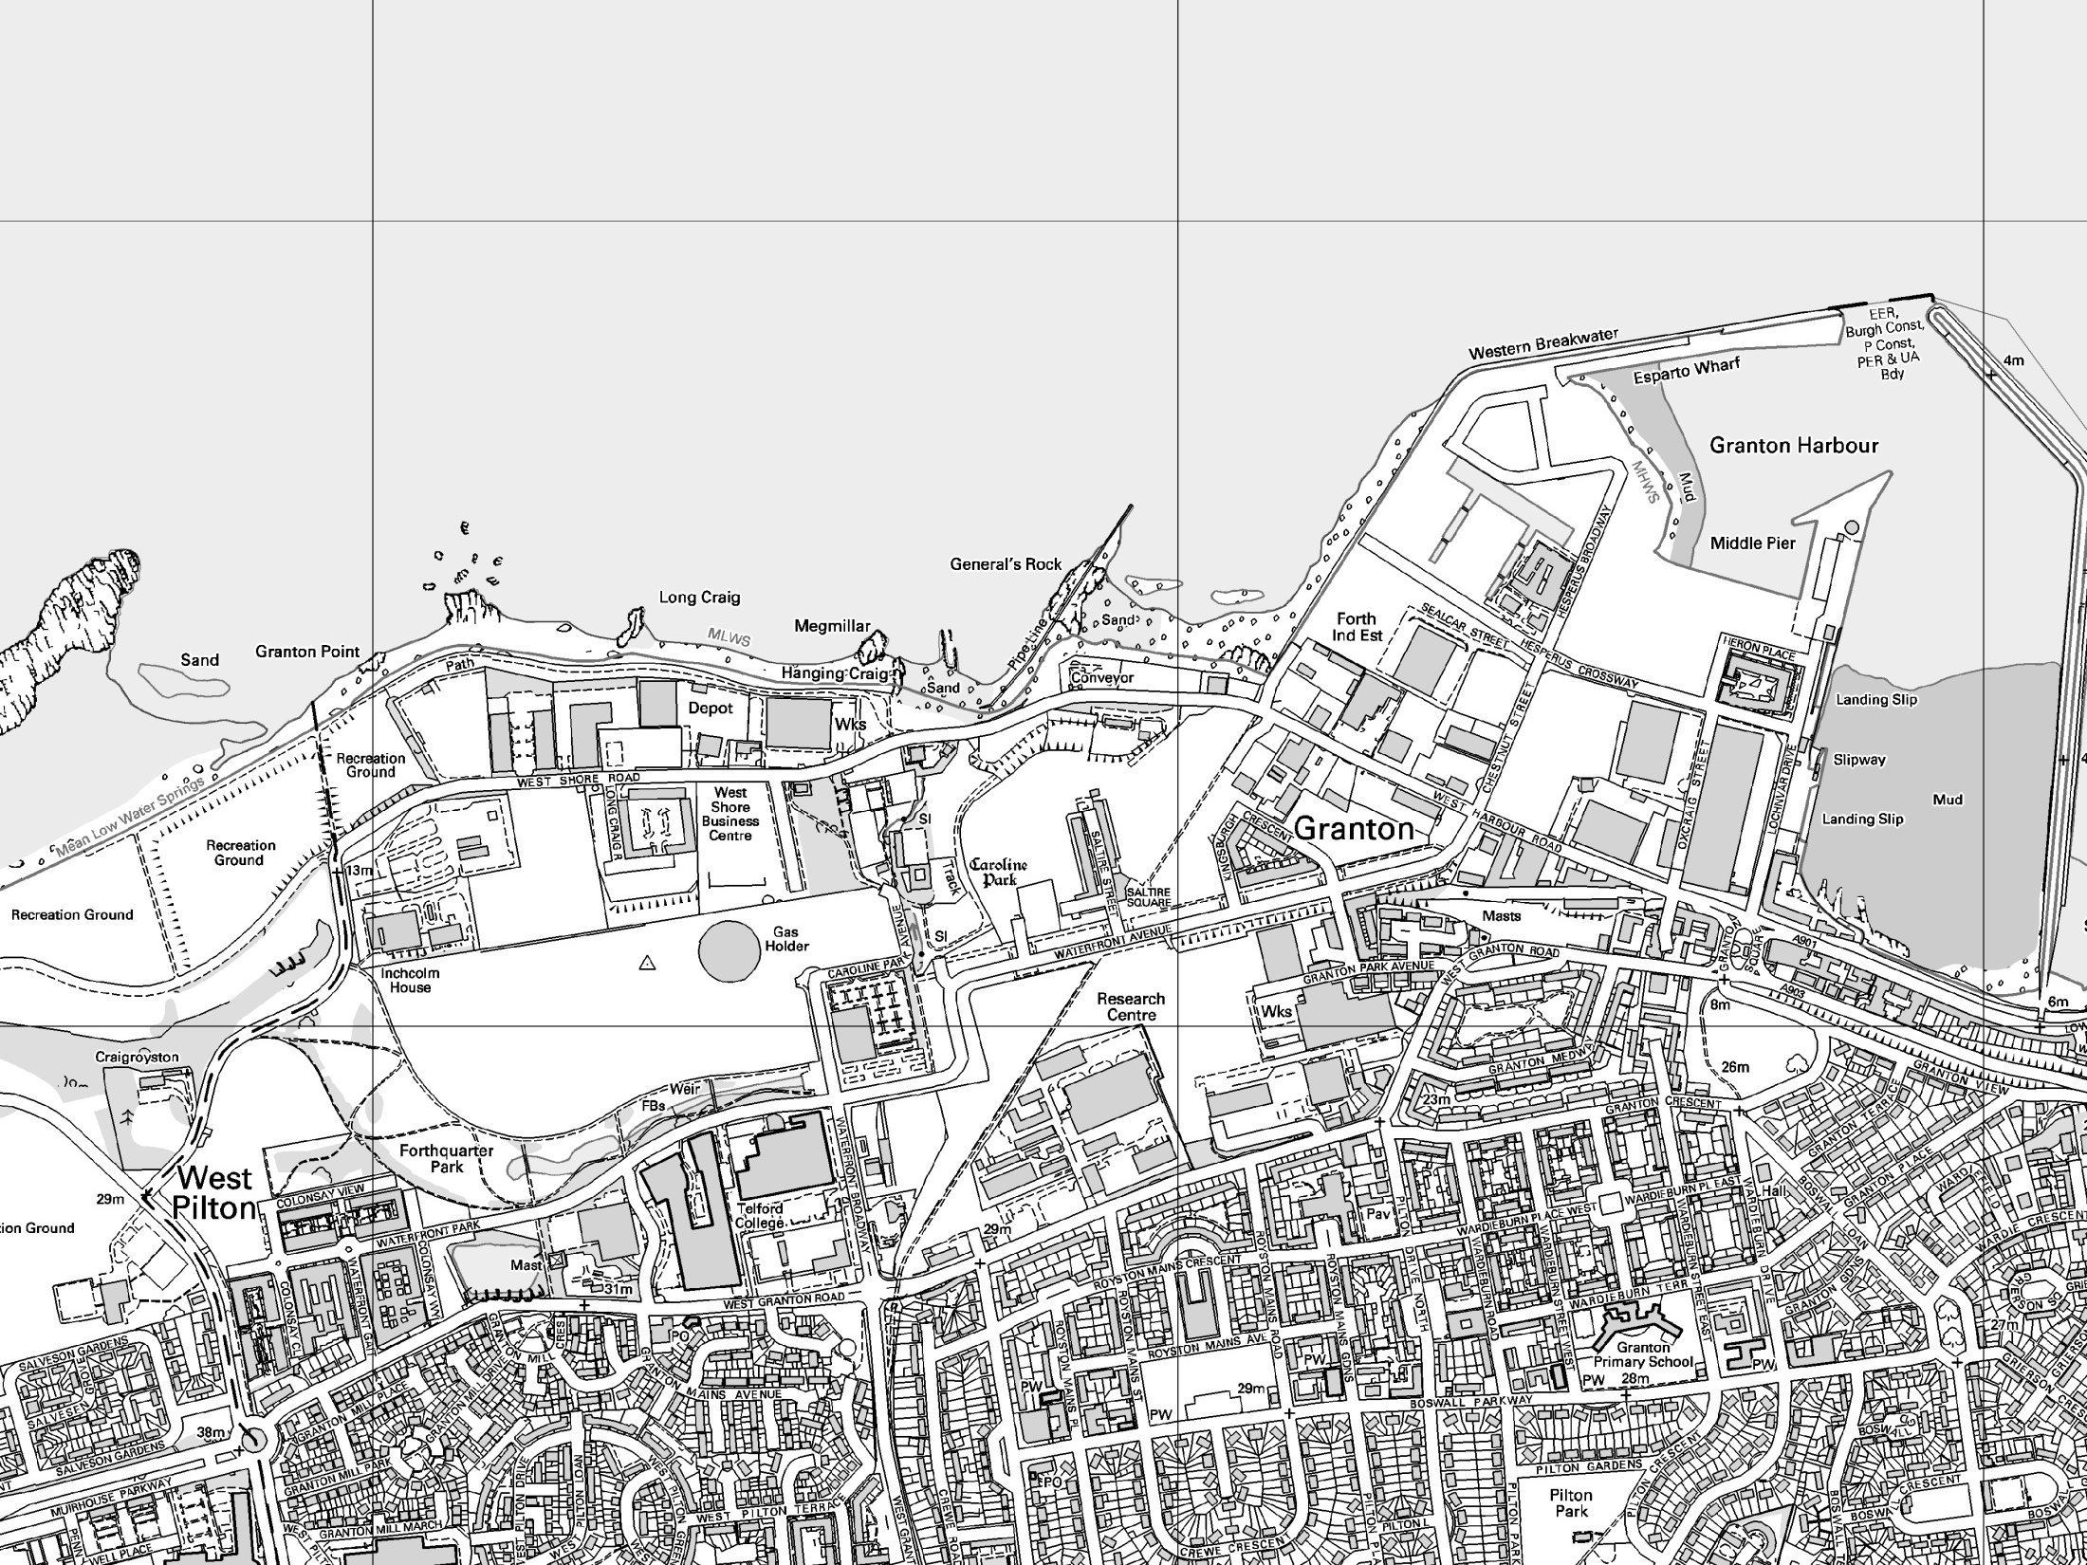
KEY
Planning Applications in Granton
Housing
Mixed-use
Offices
Other
h
i
f
g
d
e
c
b
h
b
a
c
c
b
f
e
g
a
a
d
a
c
i
J
g
i
e
h
d
b
f
f
k

Slide 9
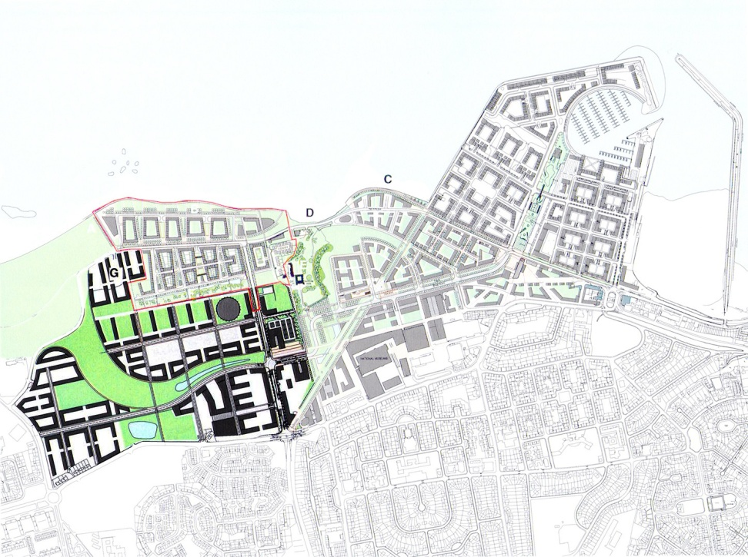
Forthquarter (National Grid)
Foster & Partners Master Plan 2003
Housing 2000 units (768 units built)
Shopping 8,900 m² (Morrisons 7271 m²)
Business 75,000 m². (Centrica 9975m²)
Open space (linear park)
Leisure/hotel (Gym/ restaurant space)
Education primary school + college. (Edinburgh College)

Slide 10
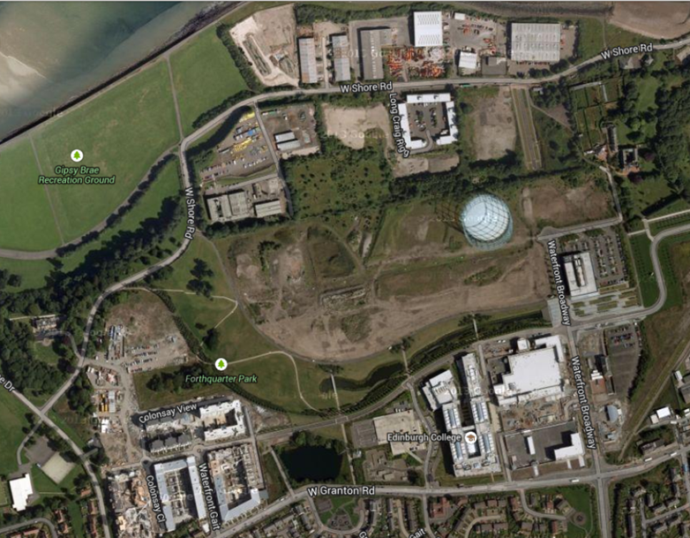
Forthquarter (National Grid)

Slide 11
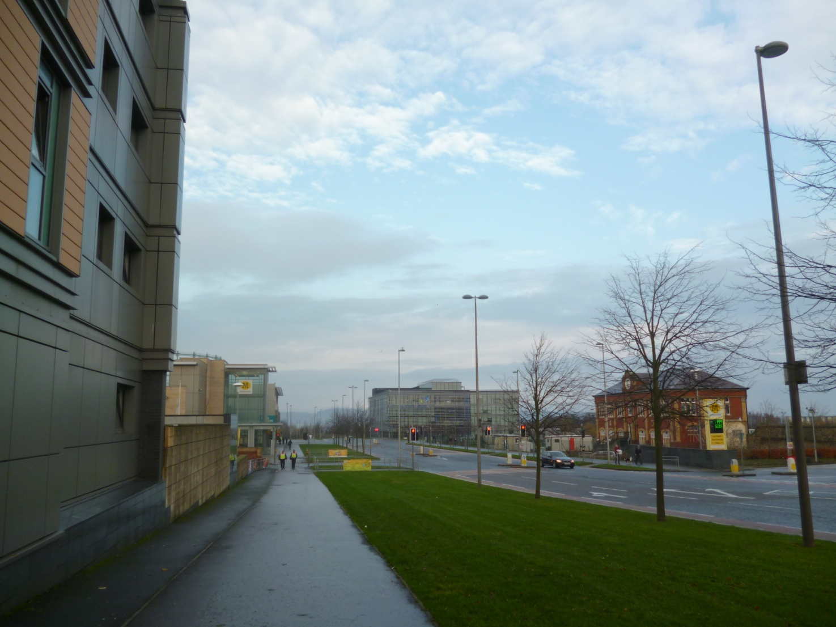
Forthquarter-Waterfront Ave

Slide 12
Forthquarter – Next Steps
Demolition of Gas Holder?
Revised master plan – reduced business, lower density housing (same numbers but larger area)
Development of former station site
Delivery of primary school

Slide 13
Central Development Area
Predominantly in EDI ownership (Council arms length company)
Major infrastructure and some residential led development delivered
Public realm and key linkages
Vacant ground floor units
New proposals anticipated

Slide 14
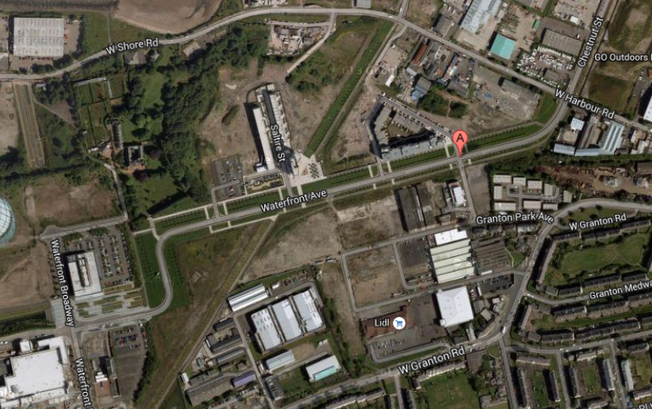
Central Development Area

Slide 15
Granton Harbour
Early phases of residential development complete (344 units)
Mainly now in ownership of Granton Central Developments Limited
Revised master plan approved in January 2014
Mixed use development incorporating marina facilities
Further revisions proposed

Slide 16
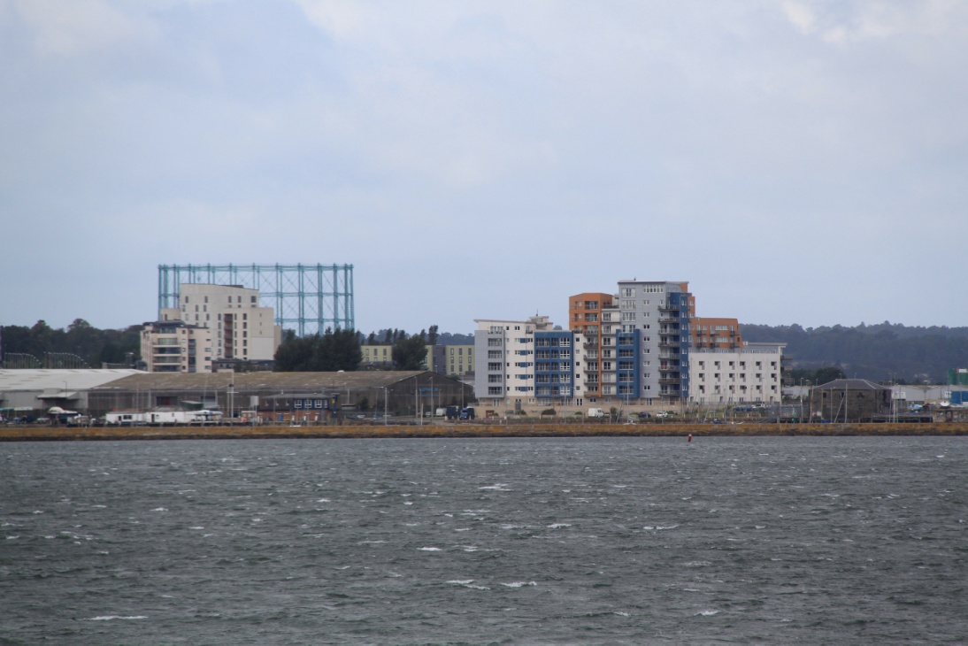
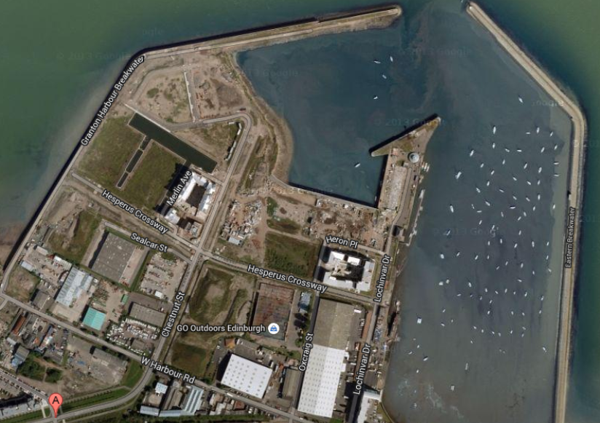
Granton Harbour
Looking south west towards gas holder

Slide 17
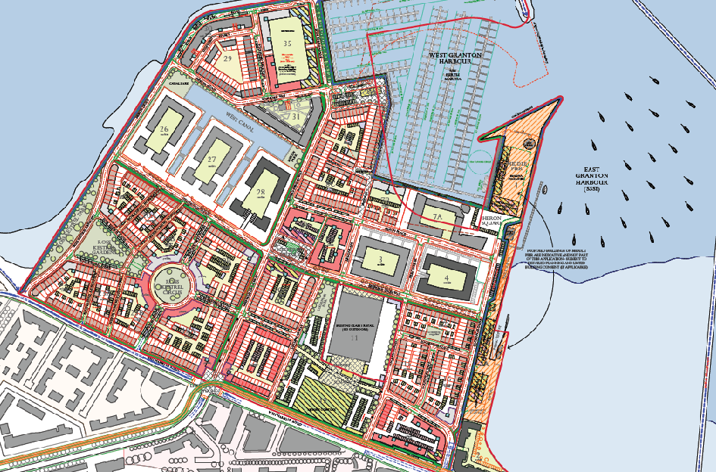
Granton Harbour Master Plan, Jan 2014
-1980 residential units
- Including 297 affordable units
- Local shopping centre
- Retail, leisure and hotel
- New marina and community boatyard

Slide 18
Granton Waterfront – Key Issues
Procedural challenges – old consents, new policy context
Delivering infrastructure and jobs
Housing numbers, types and densities
Quality of Place and sustainable development
Integration with existing communities

Slide 19
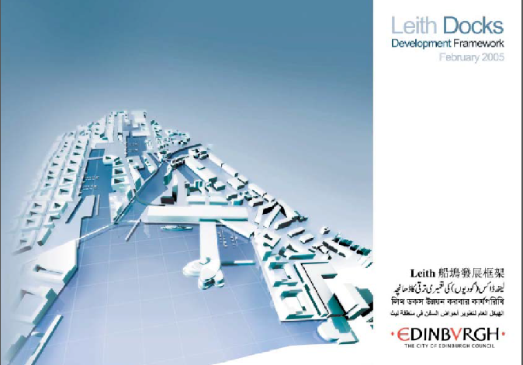
Leith Waterfront
Approved Feb 2005
Long term vision for phased redevelopment
Fundamental change in role of the Port
Mixed use redevelopment
Including up to 18,000 housing units

Slide 20
Waterfront SDA Overview
Edinburgh Waterfront Overview

Slide 21
Western Harbour - Context
Outline permission granted in Feb 2002
Urban Design Guide approved in Nov 2002, revised Sept 2004 – general principles
Detailed Urban Design Framework for each plot prepared by Forth Ports

Slide 22
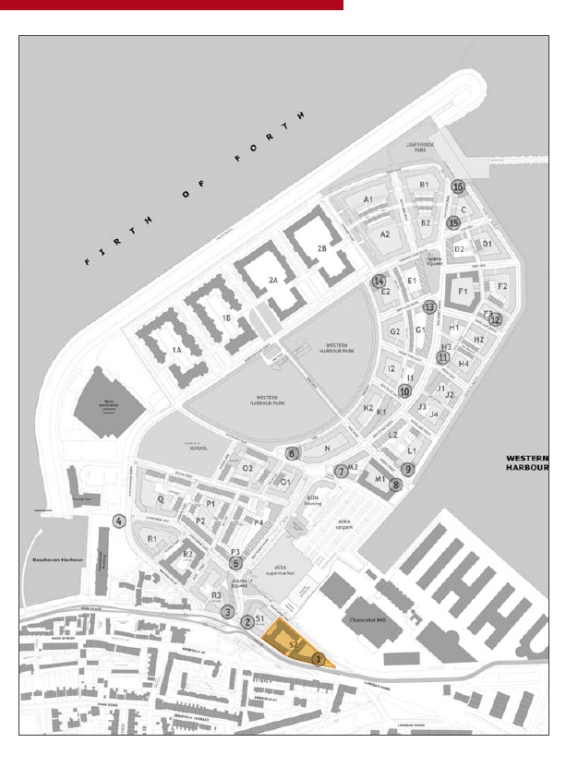
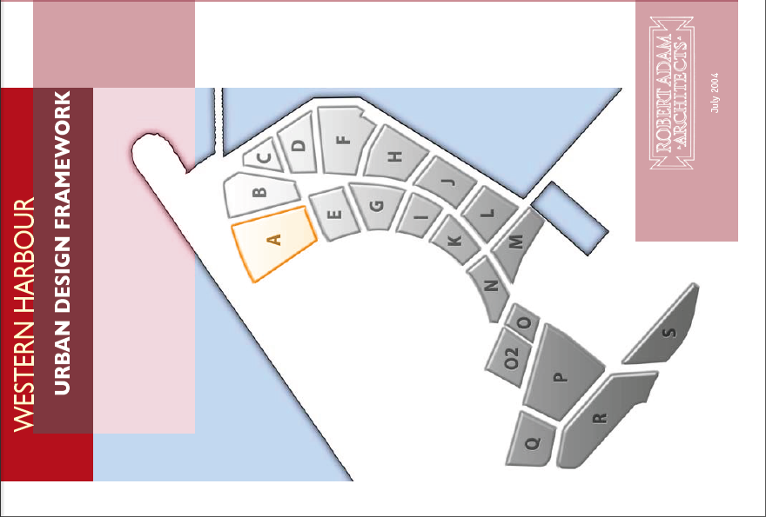
Western Harbour

Slide 23
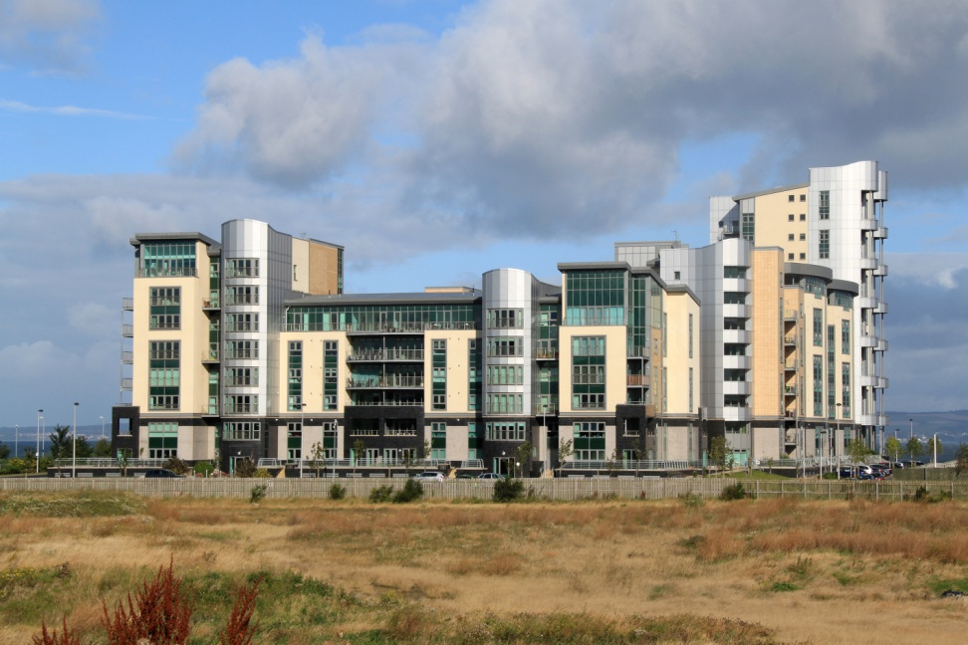
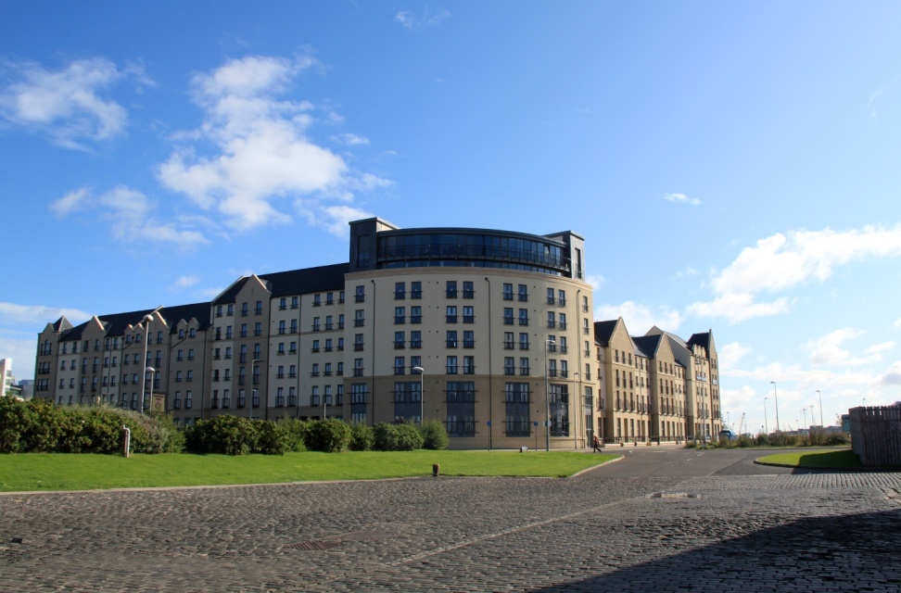
Western Harbour - Housing
3000 housing units proposed – just over 1100 developed
9 plots complete, 1 under construction

Slide 24
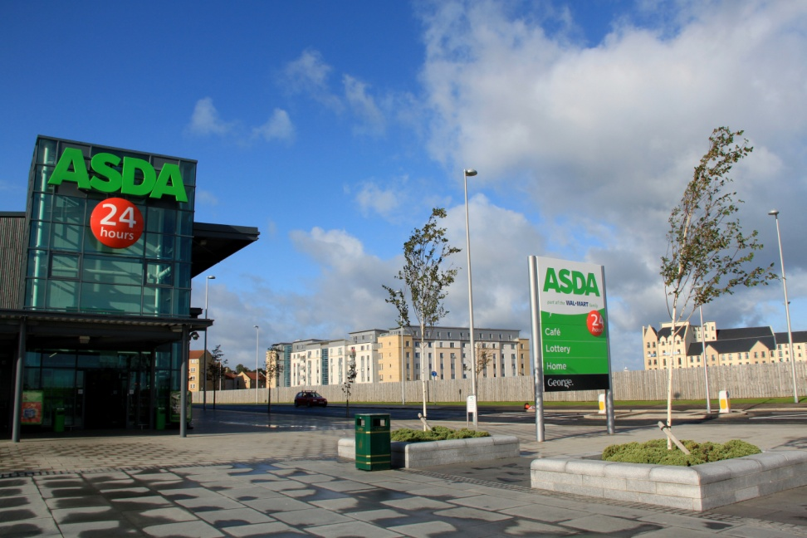
Western Harbour – Other Uses
Superstore built as part of proposed local centre
Proposed large park and primary school
Two proposed public squares

Slide 25
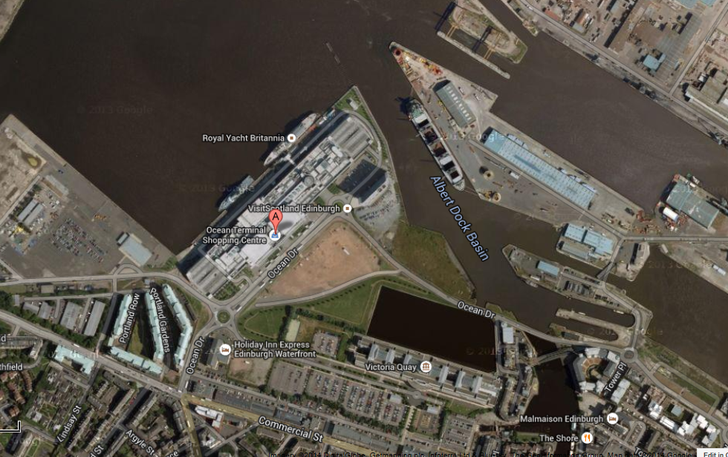
Central Leith Waterfront

Slide 26
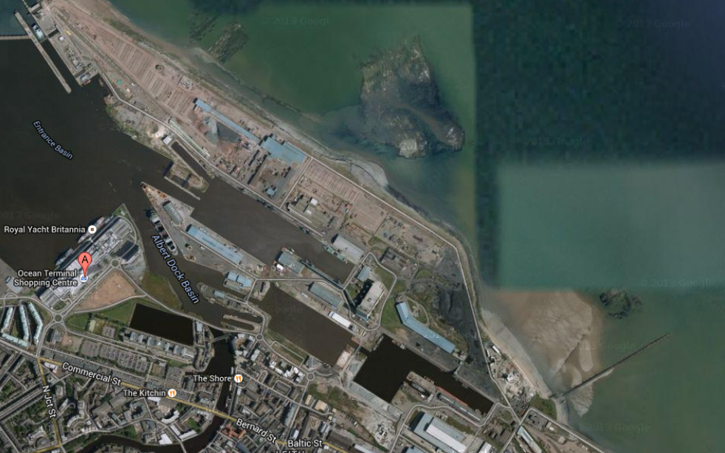
Northern and Eastern Docks

Slide 27
Leith Waterfront – Key Issues
Making development happen
Role in meeting Edinburgh’s housing need (9,000 homes proposed, less than 2000 built)
Changing and competing strategies and priorities
Better Accessibility
Quality of place and sustainable development

Slide 28
Planning for Edinburgh Waterfront in 2015
Second Proposed Local Development Plan – key development principles

Slide 29

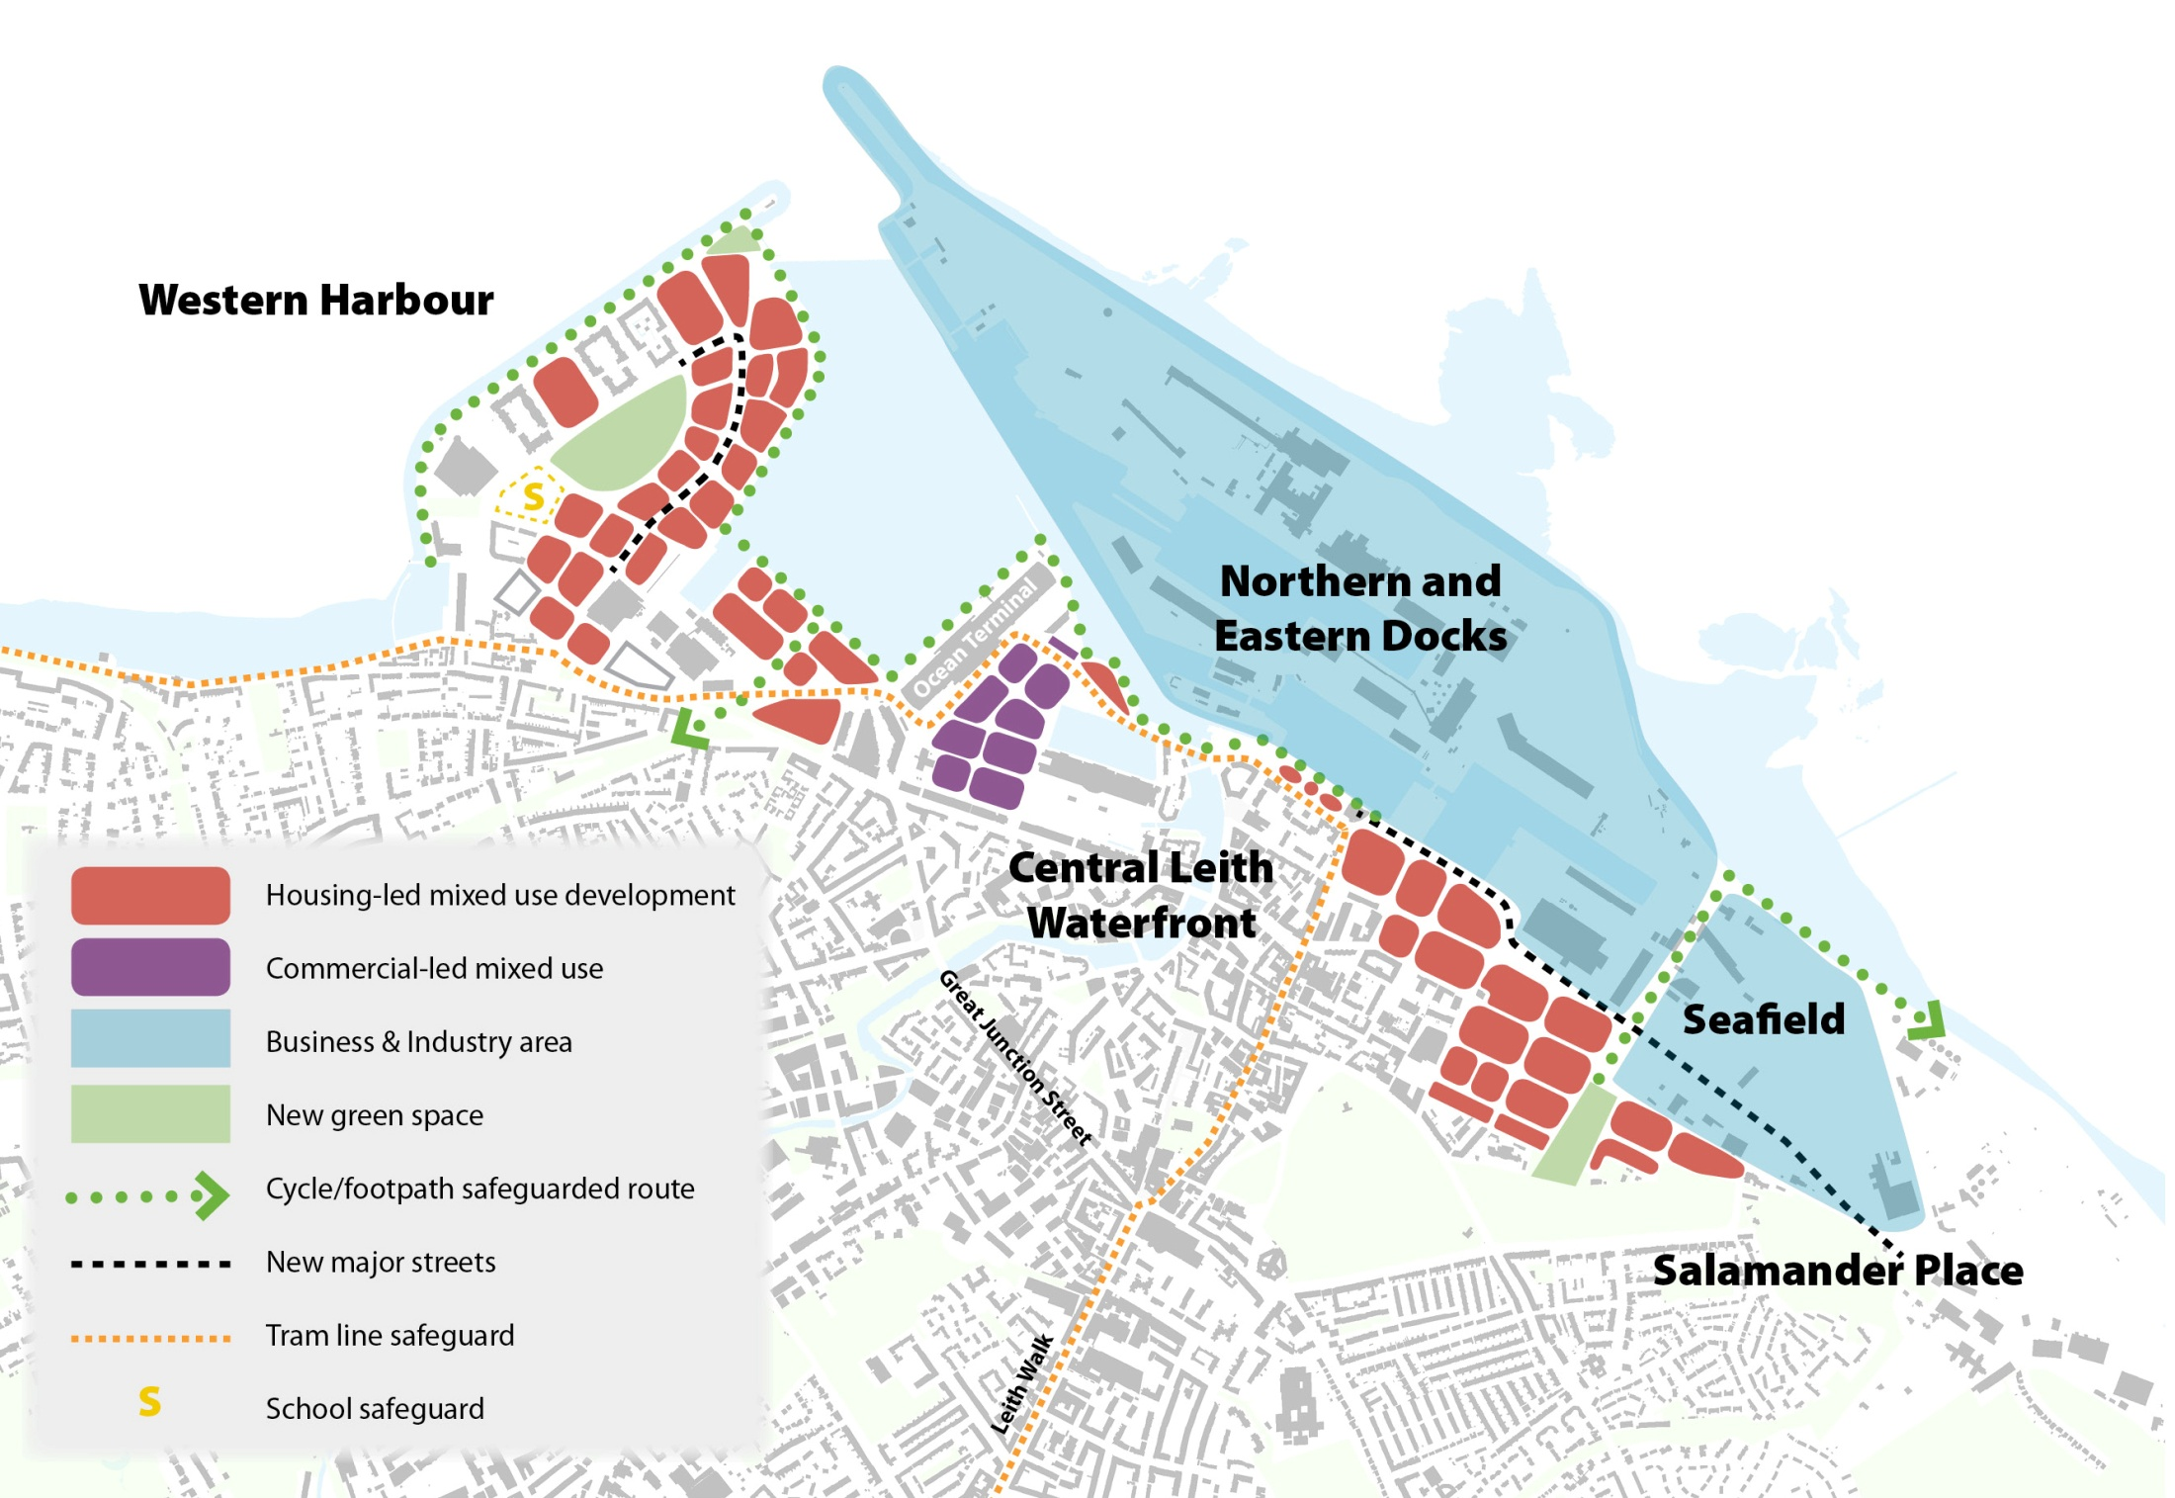
Leith Waterfront
Development Principles – Leith Waterfront

Slide 30
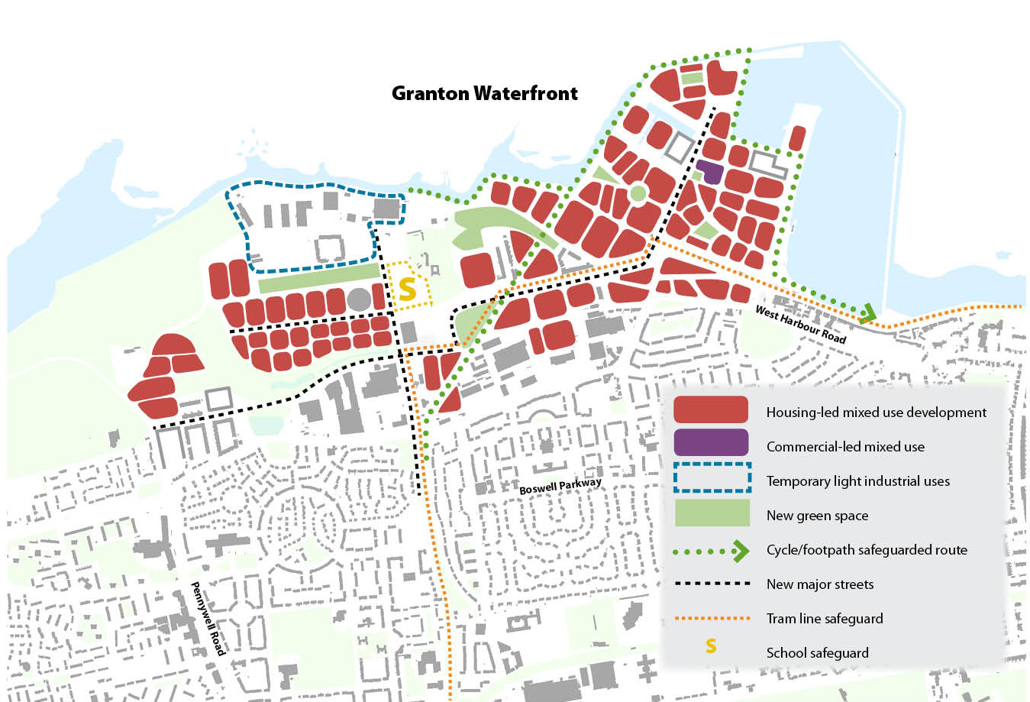
Granton Waterfront
Development Principles – Granton Waterfront

Slide 31
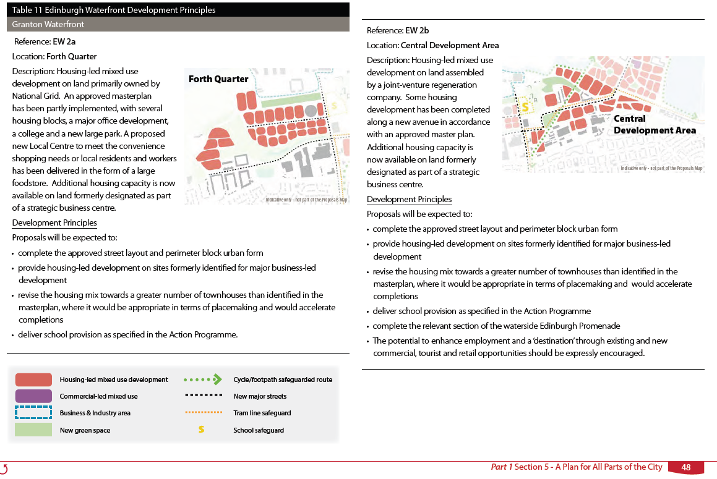
Granton Waterfront
Development Principles – Granton Waterfront

Slide 32
Planning for Edinburgh Waterfront in 2015
Second Proposed Local Development Plan – key development principles
New Majors Waterfront team – major applications, projects and delivery
Renewed focus on partnership working within Council and other stakeholders
Community engagement

Slide 33
Any questions?

